Slide 1
VHDL
Introduction
Entity
Architecture

Slide 2
Introduction
VHDL
  VHSIC (Very High Speed Integrated Circuits) Hardware Description Language
FPGA
  Field Programmable Gate Array
IEEE standard 1076
  Original version adopted in 1987
  Revised in 1993, 2000, 2002, and 2008

Slide 3
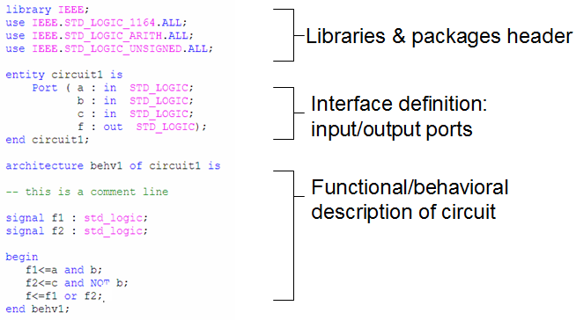
VHDL code: overview

Slide 4
VHDL code: overview
Basic constructs (building blocks)
  Entity
    Analogy: circuit symbol
    Define circuit interface
  Architecture
    Analogy: circuit diagram
    Define circuit functionality

Slide 5
VHDL code: sections
Use a library
Use packages to provide various data types
Define an entity: “circuit1”
Define the entity ports: name, mode, and data type

Slide 6
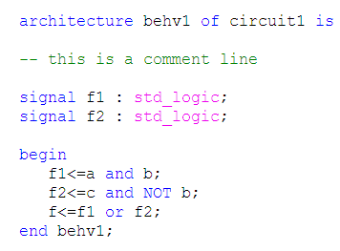
VHDL code: sections
Define an architecture “behv1” for entity “circuit1”
Comment starts with “--”
Declare internal signals: f1 and f2
Define circuit operation

Slide 7
VHDL
VHDL is NOT case sensitive
VHDL is concurrent
These statements are concurrent. They can be written in any order and the circuit operation is the same.

Slide 8
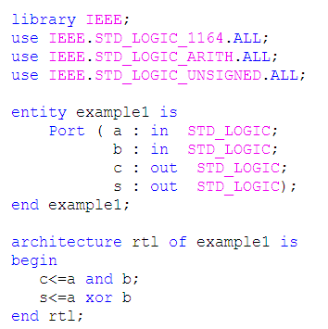
Example

Slide 9
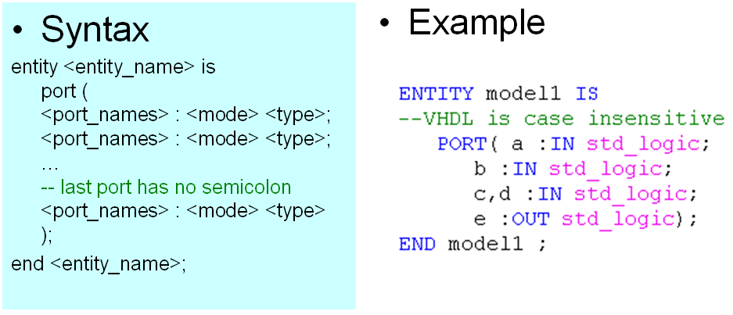
Entity

Slide 10
Entity: port mode
<mode>: indicate the port direction
  IN: port value may only be read
  OUT: port value may be updated
  BUFFER: port value may be both read and updated
  INOUT: port value may be both read and updated
BUFFER vs. INOUT (IEEE standard)
  Although signals of modes INOUT and BUFFER have the same characteristics with respect to whether they may be read or updated, a signal of mode INOUT may be updated by zero or more sources, whereas a signal of mode BUFFER must be updated by at most one source.

Slide 11
Entity: port type
<type>: indicate the signal type of the port
  bit: 0 or 1
  bit_vector: vector of bit values
  Boolean: TRUE or FALSE
  integer: integers
  std_logic: 9 values for signal value and strength
  std_logic_vector: vector of std_logic values
Part of VHDL standard
Require IEEE package

Slide 12
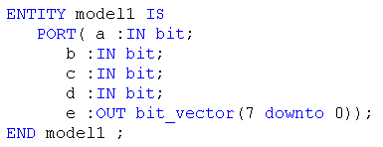
Entity: port type
Standard ‘bit’
  ‘0’: binary zero
  ‘1’: binary one
Example

Slide 13
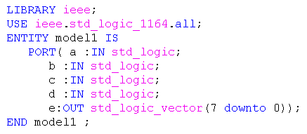
Entity: port type
IEEE ‘std_logic’ (package: ‘std_logic_1164’)
  ‘0’: binary zero
  ‘1’: binary one
  ‘Z’: high impedance
  ‘-’: don’t care
  ‘U’: uninitialized
  ‘X’: unknown
  ‘W’: weak unknown
  ‘L’: weak zero
  ‘H’: weak one

Slide 14
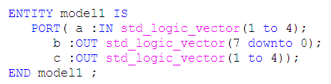
Entity: port type
bit_vector: array of bit objects
std_logic_vector: array of std_logic objects
Example
Results
  a <= “0011”: a(1)=0, a(2)=0, a(3)=1, a(4)=1
  b <= “10011000”: b(7)=1, b(6)=0, …, b(0)=0
  c <= “1011”: c(1)=1, c(2)=0, c(3)=1, c(4)=1

Slide 15
Architecture
An architecture represents one possible implementation of its associated entity
  architecture declarations: define internal signals, components, etc. to be used in architecture body
  architecture body: define implementation details of input/output relationship
Multiple architectures can exist for an entity

Slide 16
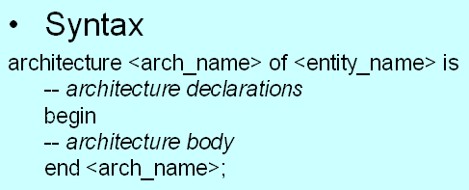
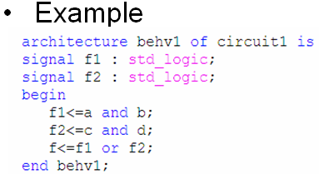
Architecture: overview

Slide 17
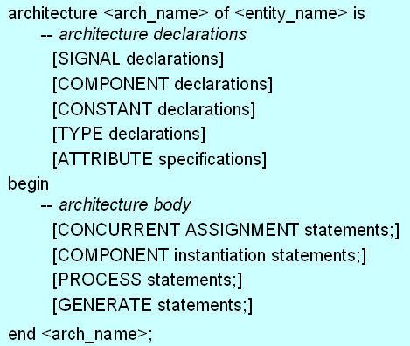
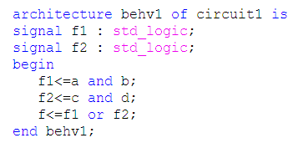
Architecture: general form
CONCURRENT ASSIGNMENT statements
SIGNAL declarations

Slide 18
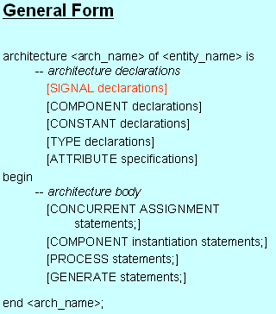
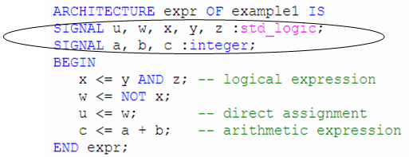
Architecture declarations: signal
For internal signals within the architecture
Syntax: signal <signal_name> : <type>

Slide 19
Architecture body
Concurrent assignment statements
  Direct signal assignment
  Selected signal assignment
  Conditional signal assignment
  Component statement
  Generate statement
Sequential assignment statements
  Process statement (IF, CASE, FOR, …)

Slide 20
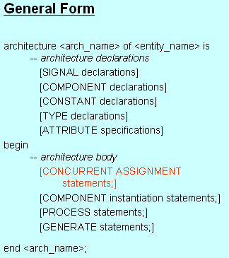
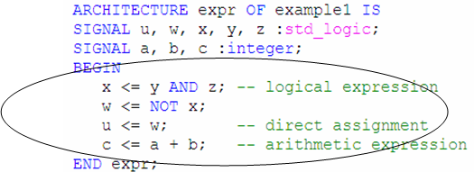
Concurrent: direct signal assignment
Syntax: <target> <= <expression>
  <target> can be an internal signal or an output port
  <expression> operates on internal signals and/or input ports

Slide 21
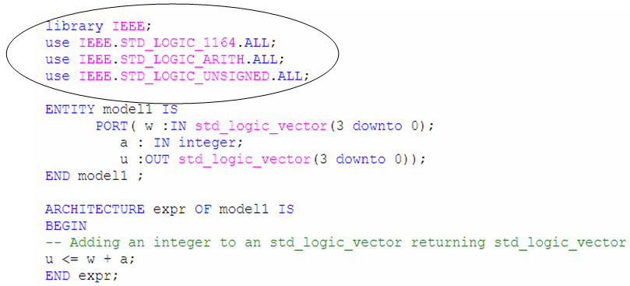
Operators and expressions
VHDL standard: arithmetic and logical operators are defined for standard integer, Boolean, bit, bit_vector types.
Logical operators using std_logic and std_logic_vector types require ‘IEEE std_logic_1164’ package
Arithmetic operators using std_logic and std_logic_vector types require ‘IEEE std_logic_unsigned’ and ‘IEEE std_logic_arith’ packages

Slide 22
Operators
Order of precedence
 | Class | Operator
Highest Lowest | Miscellaneous | NOT, abs, ** (exponentiation)
 | Multiplying | *, /, mod (modulus), rem (remainder)
 | Sign | +, -
 | Adding | +, -, & (concatenation)
 | Shift | sll, srl, sla, sra, rol, ror
 | Relational | =, /=, <, <=, >, >=
 | Logical | AND, OR, NAND, NOR, XOR, XNOR

Slide 23
Operators
Order of precedence
  Operators of highest precedence are evaluated first
  Deepest nested parentheses are evaluated first
  Operators of the same precedence are evaluated from left to right
  Logical operators have same precedence
Use parentheses to ensure correct expressions
Example: SOP form
    f <= (x1 and x2) or (x3 and x4)

Slide 24
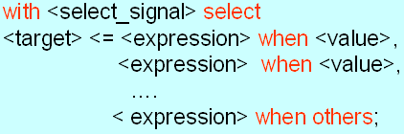
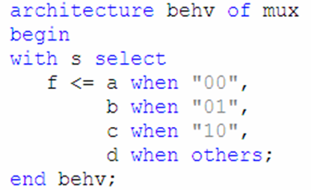
Concurrent: selected signal assignment
A signal can be assigned one of several values based on a selection criterion.
Syntax
Example

Slide 25
Concurrent: selected signal assignment
Keywords: with-select-when
  <select_signal> can be an internal signal or an input port
  <target> can be an internal signal or an output port
  <value> is one possible value of <select_signal>
  when others is required if not all values of <select_signal> are covered

Slide 26
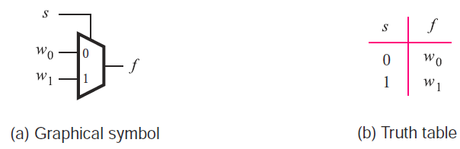
Example: 2-to-1 mux (ch. 6)
Truth table

Slide 27
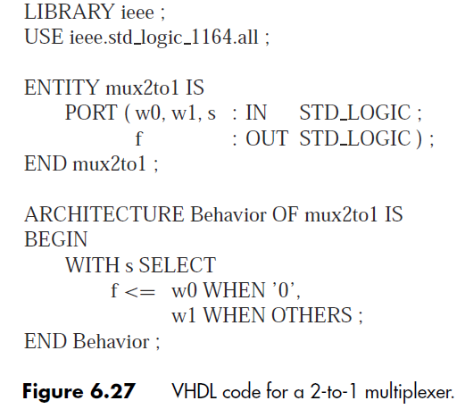
Example: 2-to-1 mux

Slide 28
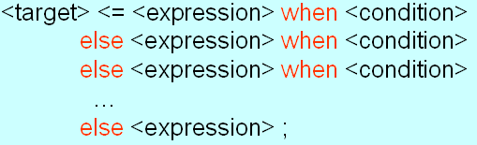
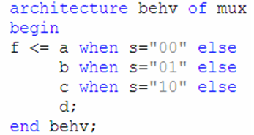
Concurrent: conditional signal assignment
A signal can be assigned one of several values based on a condition.
Syntax
Example

Slide 29
Concurrent: conditional signal assignment
Keywords: when-else
  <target> can be an internal signal or an output port
  <expression> operates on internal signals or input ports when <condition> is true
  Last else branch covers all missing conditions

Slide 30
Example: 2-to-1 mux (ch. 6)
Truth table

Slide 31
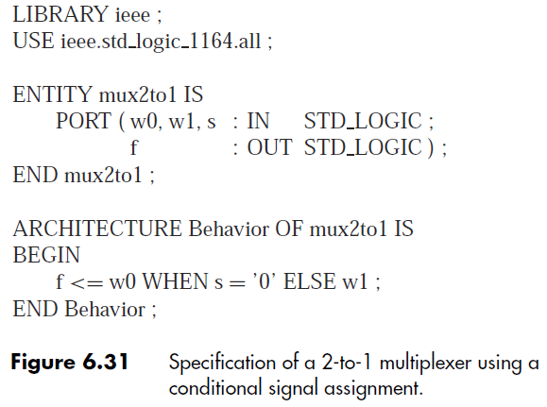
Example: 2-to-1 mux

Slide 32
VHDL design description
Behavioral
  Model a circuit based on its functionality
Structural
  Build a complex circuit based on components (lower-level circuits)

Slide 33
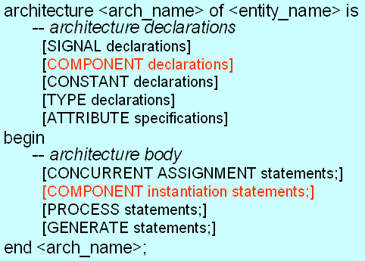
Component
An entity defined in one source code file can be used as a component in another source code file.
Requires component declaration and component instantiation statements.

Slide 34
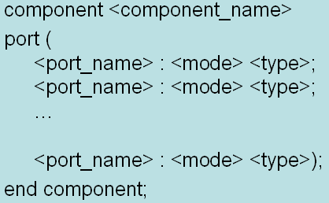
Component: declaration
Syntax
Example
  <component_name> must be the name of the entity to be used.

Slide 35
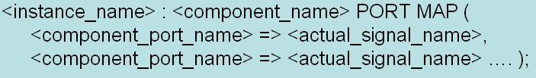
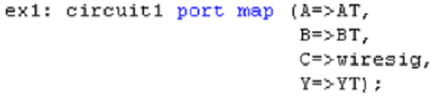
Component: instantiation
Syntax 1: positional association
Syntax 2: named association
Example

Slide 36
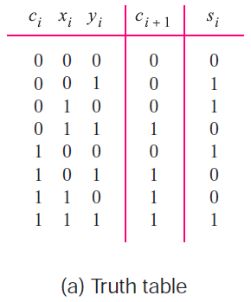
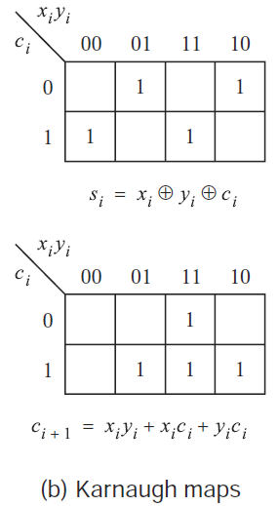
Example 1: 4-bit full adder
Truth table for 1-bit full adder

Slide 37
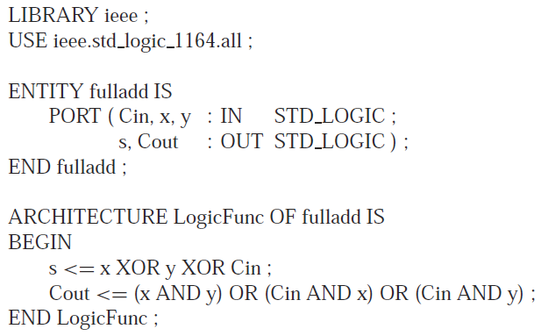
Example 1: 4-bit full adder
VHDL code for 1-bit full adder

Slide 38
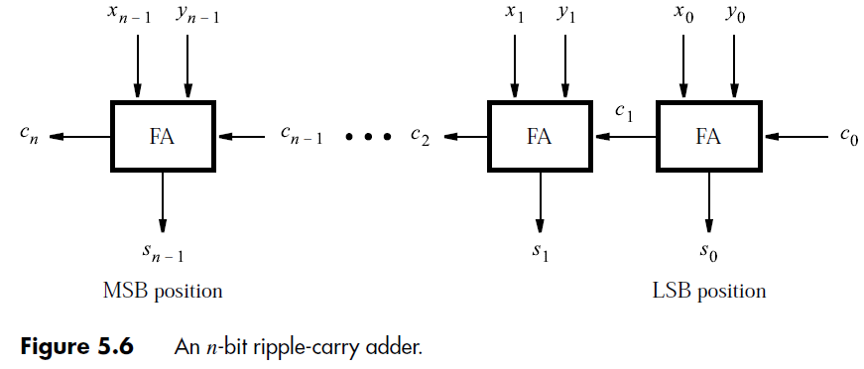
Example 1: 4-bit full adder
General form: n-bit full adder

Slide 39

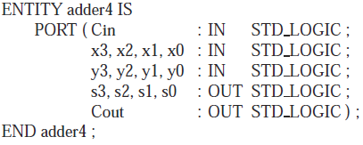
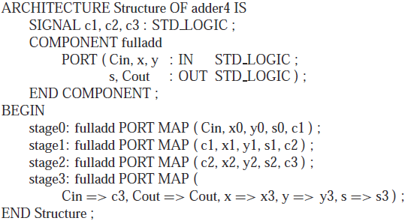
Example 1: 4-bit full adder

Slide 40
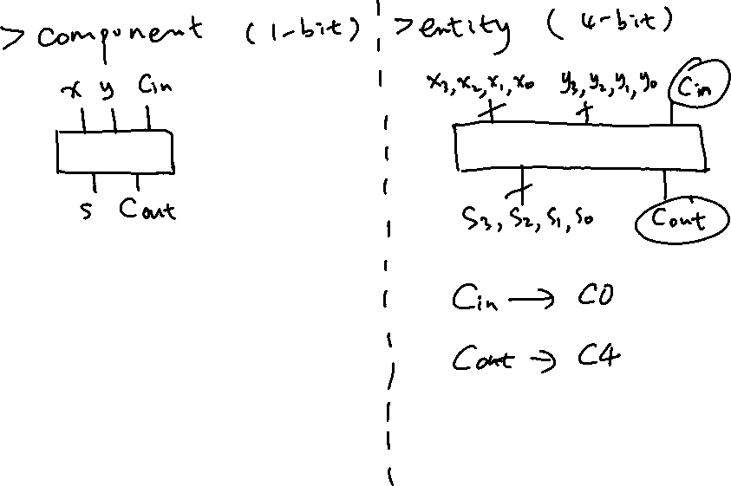
Component vs. Entity

Slide 41
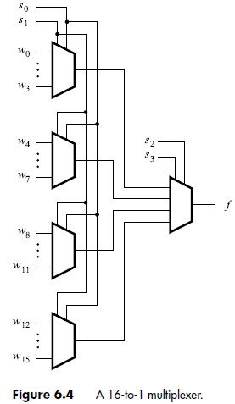
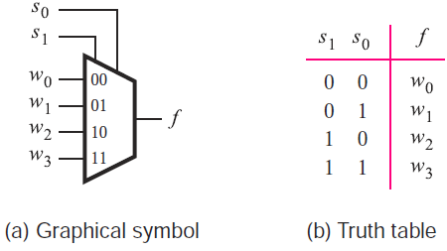
Example 2: 16-to-1 mux
Truth table for 4-to-1 mux

Slide 42
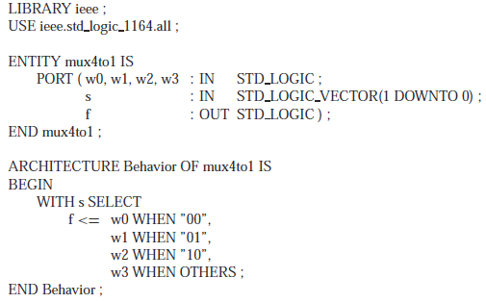
Example 2: 16-to-1 mux
VHDL code for 4-to-1 mux

Slide 43

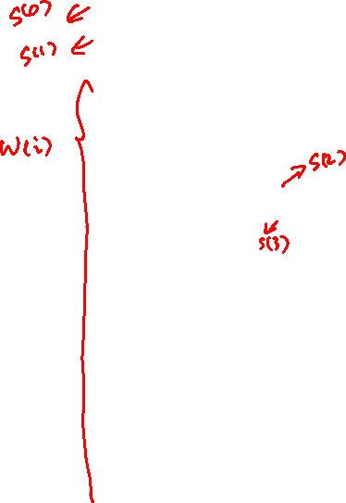
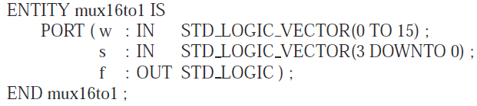

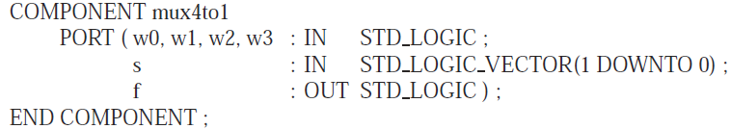
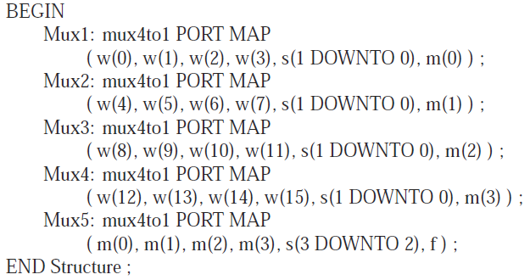
Example 2: 16-to-1 mux

Slide 44
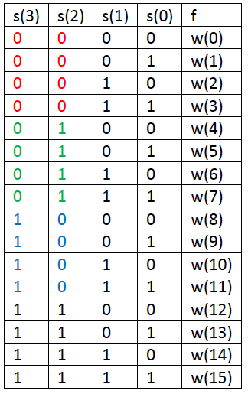
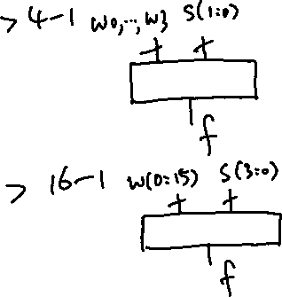
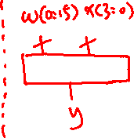
16-to-1 mux: operation
Select signal
  s(3)s(2): select block
  s(1)s(0): select input

Slide 45
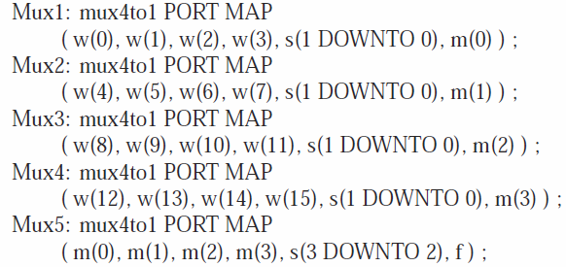
FOR GENERATE statement
A compact form to instantiate components
Example: 16-to-1 mux
Original code

Slide 46
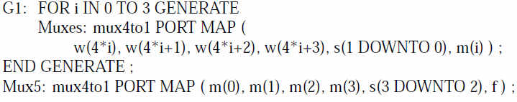
FOR GENERATE statement
Code using FOR GENERATE statement
  “G1” is a label for this statement
  “i” is a local variable whose scope is limited to this statement

Slide 47
PROCESS
Architecture
  PROCESS statements
    IF statements
    CASE statements

Slide 48
Architecture: general form
CONCURRENT ASSIGNMENT statements
SIGNAL declarations

Slide 49
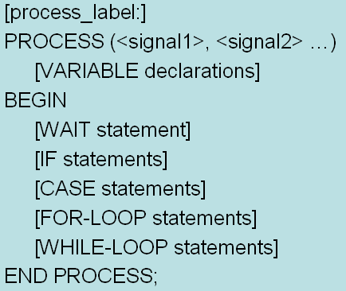
PROCESS
Multiple PROCESS statements are concurrent
Statements inside a PROCESS are sequential
Syntax

Slide 50
PROCESS
Optional: process_label
Sensitivity list: (<signal 1>, <signal 2> …)
  Specify signals that cause the PROCESS to be evaluated
  When the value of any signal in the sensitivity list changes, the PROCESS is active and the statements inside the PROCESS are executed in sequential order
  Statements inside PROCESS: IF, CASE, WAIT, LOOP

Slide 51
PROCESS
Any assignments made to signals inside the PROCESS are not visible outside the PROCESS until all the statements in the PROCESS have been evaluated.
Signal assignments only take effect at the end of the PROCESS.
If multiple assignments are made to the same signal, only the last one has any visible effect.

Slide 52
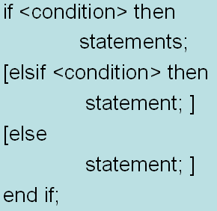
IF statement
IF statement can only appear in a PROCESS
Syntax

Slide 53
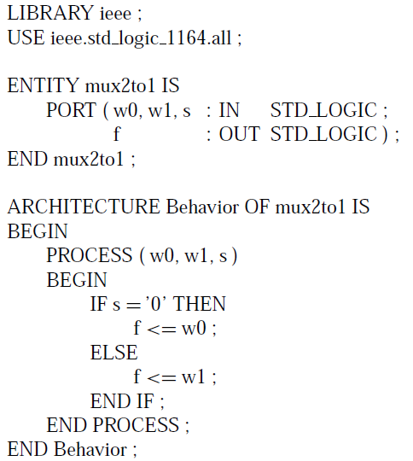
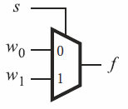

Example: 2-to-1 mux
Style 1

Slide 54

Example: 2-to-1 mux
Style 2
Default assignment
  f<=w0;
  This assignment is scheduled to occur after all statements in the PROCESS have been evaluated
  Default value may be overridden

Slide 55



Sequential statements
Ordering of statements in a PROCESS can affect the meaning of the code
Order 1
  Circuit: 2-to-1 mux
  Function:
Order 2
  Function:

Slide 56

CASE statement
CASE statement can only appear in a PROCESS
Syntax

Slide 57

Example: 2-to-1 mux

Slide 58

Example: 2-to-4 binary decoder
Truth table

Slide 59



Example: 2-to-4 binary decoder

